Slide 1


TECHNIX:
VEHICLE ASSISTANCE PLATFORM
Innovating Roadside Assistance

Slide 2

INTRODUCTION
Technix is an innovative platform designed to offer on-demand mechanical help to drivers facing vehicle issues. Built on the MERN stack, it connects users with nearby mechanics in real-time.

Slide 3




USES OF TECHNIX
Platform designed to offer on-demand mechanical help to drivers facing vehicle issues
EMERGENCY ASSISTANCE:
SCHEDULED SERVICES
REAL-TIME TRACKING
Immediate help for breakdowns
Routine maintenance and repairs
Locate nearby garages effortlessly

Slide 4


ADVANTAGES
Fast Response Times: Quick access to help.
Verified Mechanics: Quality assurance for users.
Convenience: Services at the user's location.

Slide 5

UNIQUENESS OF TECHNIX
O1
INTEGRATION OF REAL-TIME TRACKING
O2
COMPREHENSIVE SERVICE OFFERINGS BEYOND JUST EMERGENCY HELP
O3
PARTNERSHIPS WITH LOCAL MECHANICS FOR COMMUNITY SUPPORT

Slide 6
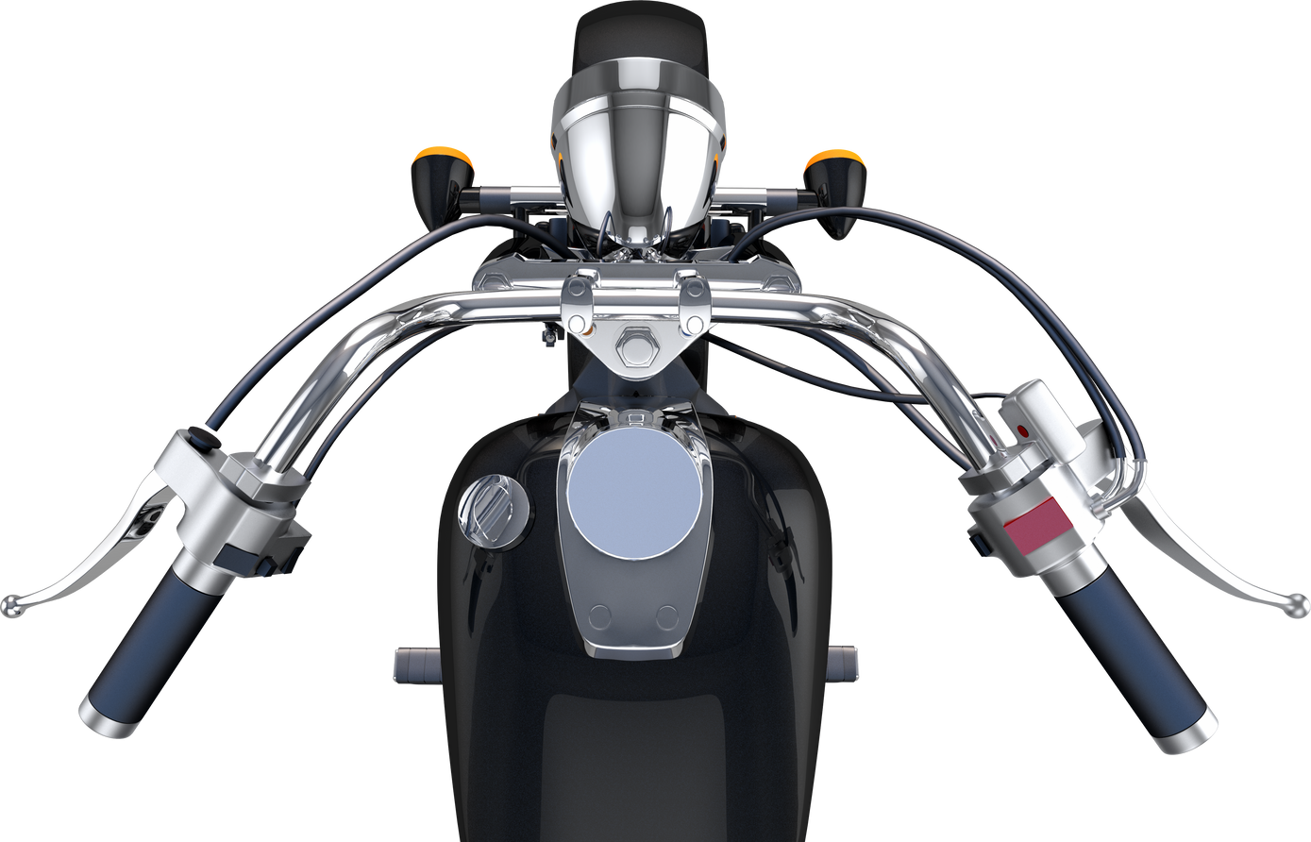
VALUE ADDITION
User Convenience: Hassle-free access to services
Cost-Effectiveness: Competitive pricing for services.
Enhanced Safety: Reducing risks associated with breakdowns

Slide 7
SCOPE OF BUSINESS
Platform designed to offer on-demand mechanical help to drivers facing vehicle issues
TARGET MARKET: URBAN AND SUBURBAN DRIVERS
EXPANSION POTENTIAL: OPPORTUNITIES FOR SCALING SERVICES
FUTURE PARTNERSHIPS: COLLABORATIONS WITH INSURANCE AND AUTO PART SUPPLIERS.

Slide 8

MARKET TRENDS
O1
INCREASING RELIANCE ON MOBILE APPS FOR SERVICES.
O2
GROWTH IN ON-DEMAND SERVICE PLATFORMS.
O3
RISING AWARENESS OF VEHICLE MAINTENANCE.

Slide 9


POTENTIAL IMPACT
Reduced traffic congestion due to efficient assistance
Increased customer satisfaction with timely services
Job creation opportunities for local mechanics.

Slide 10

CONCLUSION
Technix is poised to revolutionize roadside assistance, offering a comprehensive platform for drivers, mechanics, and the community. Join us in shaping the future of vehicle assistance.

